Slide 1


E-Commerce Website
FRONT-END
PROJECT
Presented by: Abhinav Rawat
Roll No: 2110990055
Group No: G05
Total No of Pages: 20
Submitted To - Mr. Lavish Arora

Slide 2
OVERVIEW
01
02
03
Introduction
Why Choose Us
Goals
04
05
06
Challenges
Project Overview
Future Scope

Slide 3
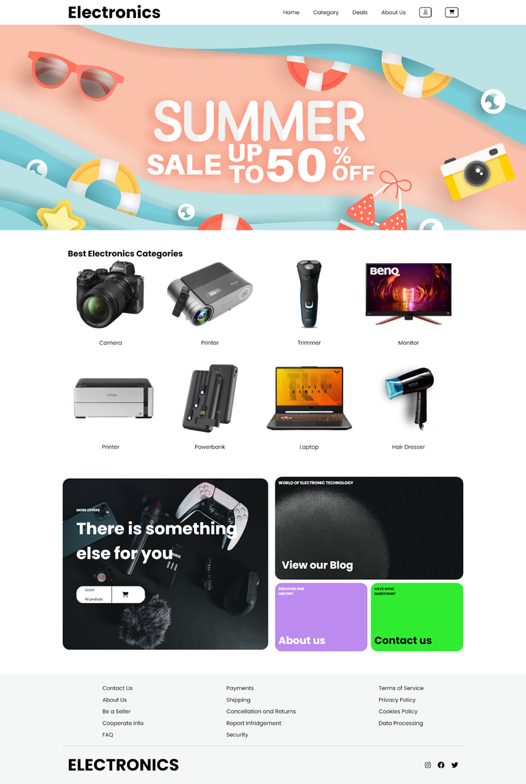


INTRODUCTION
Welcome to our college front-end project, a showcase of our skills and knowledge in web development. This project was created using JavaScript, HTML, and CSS to demonstrate our ability to design a user-friendly and visually appealing website. Our primary focus was on delivering an exceptional user experience while applying best practices in front-end development.
This project allowed us to apply what we've learned and gain practical experience in the field. It reflects our dedication to web development and showcases our problem-solving and skills. In the following sections, we'll delve into the project's features and technologies used to bring it to life. Thank you for joining us on this journey through our project.

Slide 4





WHY CHOOSE NAME
The choice of the name "ELECTRONICS" for your e-commerce site can be influenced by several factors:
01
If your e-commerce store specializes in electronic products such as smartphones and other electronic gadgets, naming it "ELECTRONICS" clearly communicates your niche and the type of products you offer.
02
The name "ELECTRONICS" is straightforward and easy to remember. It conveys the nature of the products without ambiguity, making it easier for potential customers to understand what your store sells.
03
Choosing a specific and clear name like "ELECTRONICS" can help in building a strong brand image. Customers looking for electronic products may find the name appealing and memorable.
04
·While the primary focus is on electronics, the name "ELECTRONICS" doesn't limit you to a specific subset of electronic products.

Slide 5




GOALS
Develop a responsive and user-friendly interface that allows customers to easily browse products, view details, and make purchases, ensuring a seamless experience on both desktop and mobile devices.
Design a streamlined and secure checkout process with multiple payment options, guest checkout feature, and real-time order tracking, minimizing cart abandonment and ensuring a smooth transaction flow.
Present products in an appealing and organized manner, including high-quality images, detailed descriptions, and customer reviews, enhancing the overall shopping experience.

Slide 6

Challenges
Ensuring the website functions correctly and appears consistent across different web browsers (Chrome, Firefox, Safari, etc.) can be challenging due to varying rendering engines and standards.
1.
Designing a responsive layout that adapts seamlessly to various screen sizes and orientations, including smartphones, tablets, and desktops, requires careful planning and testing.
2.
Handling and displaying a large volume of product data, including images, descriptions, prices, and customer reviews, while maintaining website performance can be challenging.
3.
Integrating third-party services such as payment gateways, shipping providers, and customer relationship management (CRM) systems, while ensuring smooth communication and data exchange, can pose integration challenges.
4.
·Keeping the HTML, CSS, and JavaScript codebase organized, scalable, and maintainable, especially as the project grows, is crucial to facilitate future updates and additions.
5.

Slide 7

Project Overview
In the project that has been shown below, I have tried to create a website using HTML, CSS and JavaScript with proper payment gateway i.e., it has some constraints which won’t allow user to put false or empty input in the data base. User can’t use online payment if he hasn’t selected the online payment as the payment mode. Further more basic functionalities like carousels have been added which further adds up to user experience. Colour and aesthetics of site has been kept simple and minimal to further increase user appeal. Different category pages are made for easier browsing to find your favourite in a nick of a time.

Slide 8
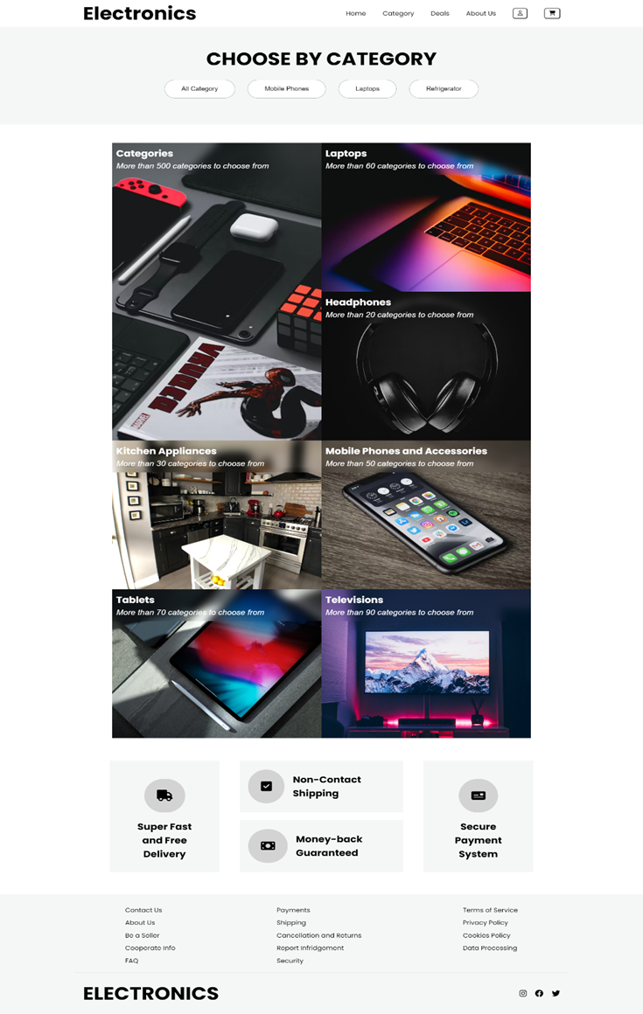
Category Page

Slide 9
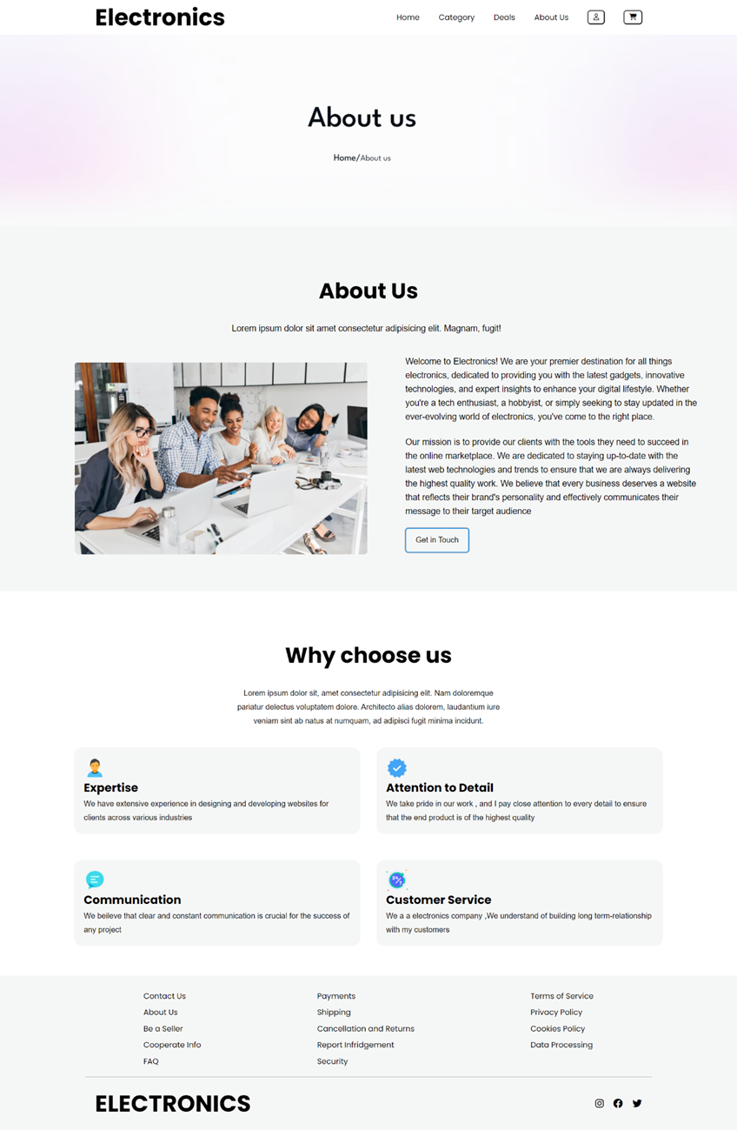
About US Page

Slide 10
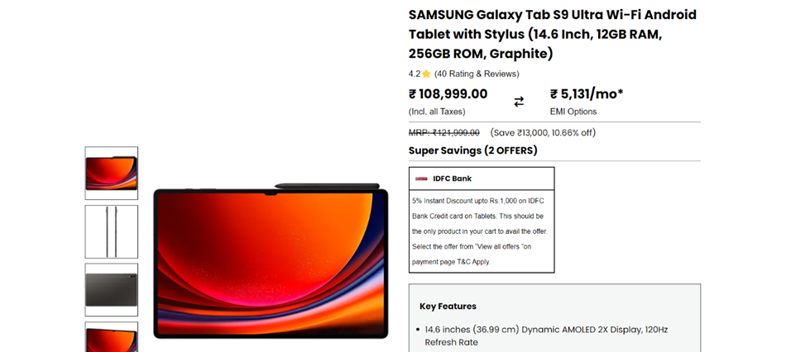
Single Product Page

Slide 11




FUTURE SCOPE
Consider developing a dedicated mobile application for "APPLIANCES" to provide a seamless and optimized shopping experience for mobile users.
Implement advanced personalization techniques and artificial intelligence to provide customers with product recommendations, personalized content, and a tailored shopping experience.
Introduce subscription services for regular appliance maintenance, filter replacements, or exclusive access to new products.

Slide 12

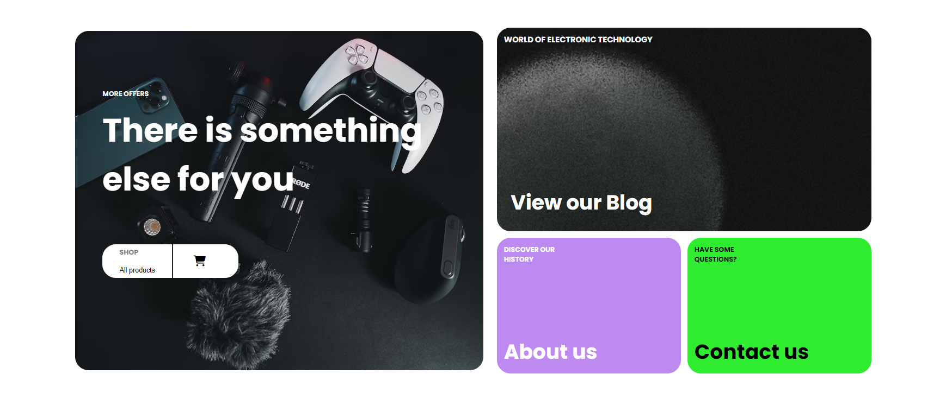
E-Commerce Website
Thank You

